Slide 1
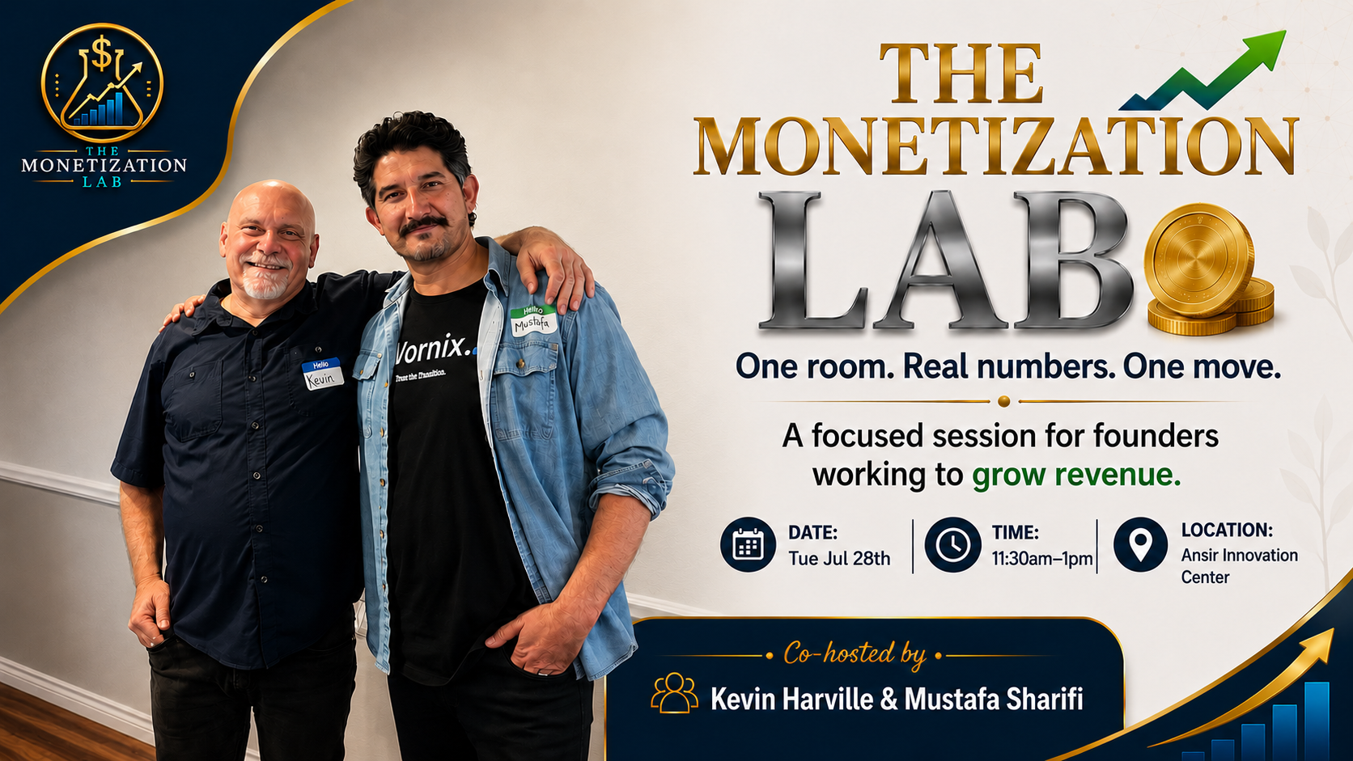

Slide 2

FAST REVENUE
You don't plant. You harvest.
Fast revenue rarely comes from brand-new things. It comes from the warm opportunities you're already sitting on.
What's already warm that you've been ignoring?
Notes:
1 minute. The reframe. In 30 days you don't have time to plant a whole new field, you harvest. The question: what is already warm that you've been ignoring? Hold on the question for a beat, then move.

Slide 3
THE PLAY
Three moves. Pick one.
1
2
3
Reactivate what's warm
Sell a small first step
Make one specific ask
Follow up on people who already know you
Lower the risk, get money moving
To one specific person
Most founders sit on warm revenue while chasing cold strangers.
Notes:
Overview of the three moves. Don't read the cards, just frame it: three moves, and by the end you pick one. Then walk through each.

Slide 4

MOVE 1
Reactivate what's warm
The demo you sent
The client from last year
The "let me think about it"
The referral that never came
One honest follow-up reopens more revenue than 50 cold messages.
Notes:
Move 1, ~2 min. These people already know you. The fastest money is reactivation, not cold outreach. Give a real example if you have one.

Slide 5

MOVE 2
Sell a small first step
People hesitate when the first offer feels too big. So don't start there.
Audit
Diagnostic
Setup
Quick review
Pilot
Short session
Low risk for them. Money moving for you. It opens the bigger sale.
Notes:
Move 2, ~2 min. Don't lead with the biggest thing. A small paid entry lowers their risk, gets money moving, and opens the door to the full engagement.

Slide 6

MOVE 3
Make one specific ask
VAGUE
"Let me know if you know anyone."
SPECIFIC
"Do you know one dentist who's missing calls?"
"One founder who needs more booked appointments?"
"One owner trying to get five more clients this month?"
Specific asks get specific intros. Vague asks get ignored.
Notes:
Move 3, ~2 min. The contrast is the whole point. Read the vague one flat, then the specific ones with energy. Specific asks get specific intros.

Slide 7
WORKING IT WITH YOU
I'm doing this right now.
My 30-day move isn't chasing a hundred new leads. I already have warm conversations, AI receptionist demos in front of clinics. So my move is move number one: follow up, sharpen the offer, and close one paid pilot.
I'm not teaching this from the outside. I'm working the same question with you.
Notes:
2 min. The honest example. This builds trust because you're in it too. Say it plainly, don't oversell. This is the part the room remembers.

Slide 8
YOUR TURN
Which one is sitting right in front of you?
Not all three. Just one.
→
A warm lead to follow up with?
→
A small paid first step to offer?
→
A specific person to ask?
Pick one. Write it on your Revenue Move Plan. That's your move.
Notes:
3 min. Hand it to the room. Ask the question, then STOP TALKING. Let the silence pull answers out. 'Who wants to name theirs first?' Then let founders go. This is where the room does the work.

Slide 9
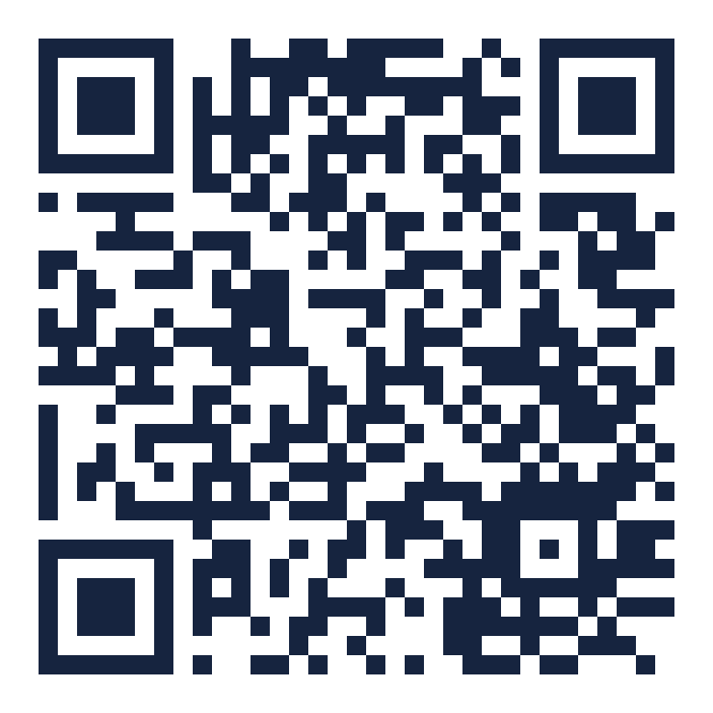
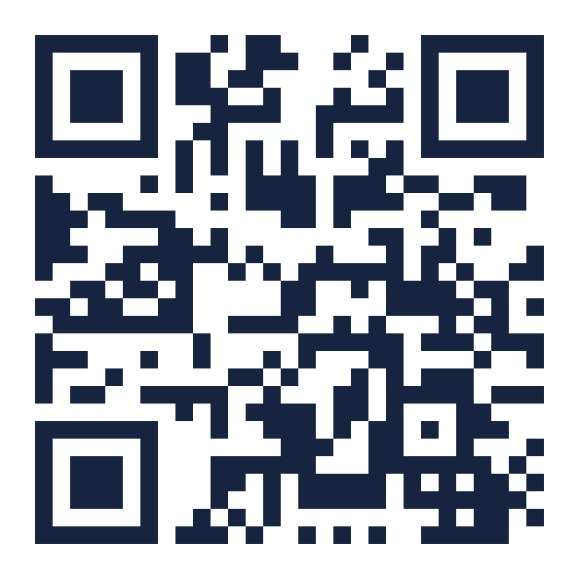
STAY IN TOUCH
Let's connect on LinkedIn.
Scan to connect, we'd love to stay in touch and keep you posted.
Kevin's QR here
Mustafa Sharifi
Kevin Harville
Vornix.ai
New Eras Media
Notes:
PRESENTER: BOTH — final slide
Invite everyone to scan and connect. Kevin: drop your own LinkedIn QR into the right card before the event (replace the dashed placeholder). This is your warm-connection capture on top of the name sheet.

